Slide 1
Napoleon’s Big Mistake

Slide 2
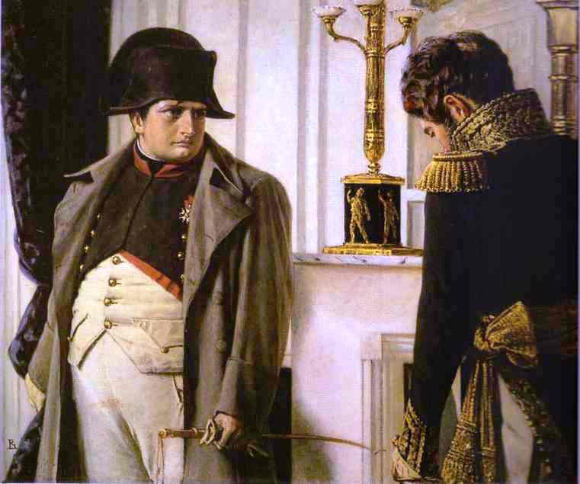

Slide 3
Strategic Master
From Exile to Master of France in 100 Days
Brought army to Belgian to face 2 armies: - British in the North
- Prussians in the East
Split the British and Prussian Armies

Slide 4
The Battle of Waterloo
Napoleon’s advantages:
Skilled Artillery
Superior numbers
Best Soldiers

Slide 5
Disadvantages
Missing best generals – impulsive Marshal Ney
Heavy rain the day before
British were on the brow of the hill
British had 2 farmhouses
The Prussians were coming to support – needed to win by tea-time
Piles – unable to sit on a horse for long

Slide 6
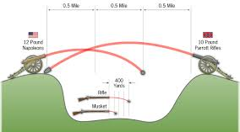
Weapons

Slide 7
Sharp weapons

Slide 8
Cavalry

Slide 9
