Slide 1
Polyhedrons
Samuel Iren Křen & Jaroslav Horníček
3.X

Slide 2
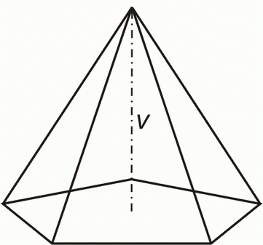
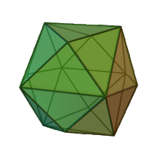
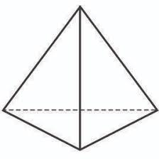
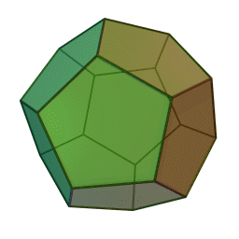
Division of polyhedrons
Pyramids
Prisms - cube, cuboid
Regular polyhedrons - tetrahedron, hexahedron, oktahedron, ...

Slide 3
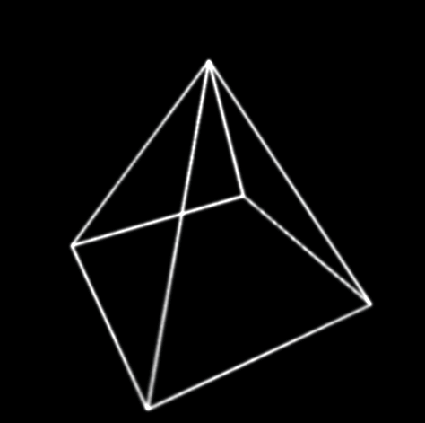
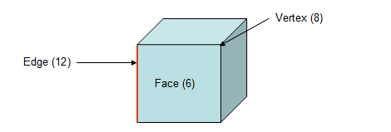
Basic information
Polyhedron is a body made of various faces, which are connected into one body by lines. These lines are called edge of polyhedron
Point where edges are connected is called vertex

Slide 4
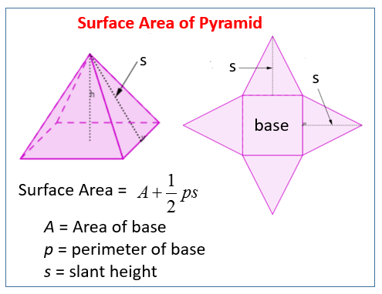
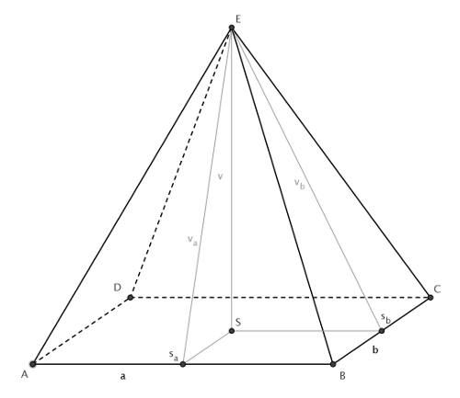
Pyramid
It is three-dimensional body, his base is polygon. His edges are connected in one point, which is called the main vertex of pyramid.
Egyptians used to build these bodies as tombs for their rulers

Slide 5
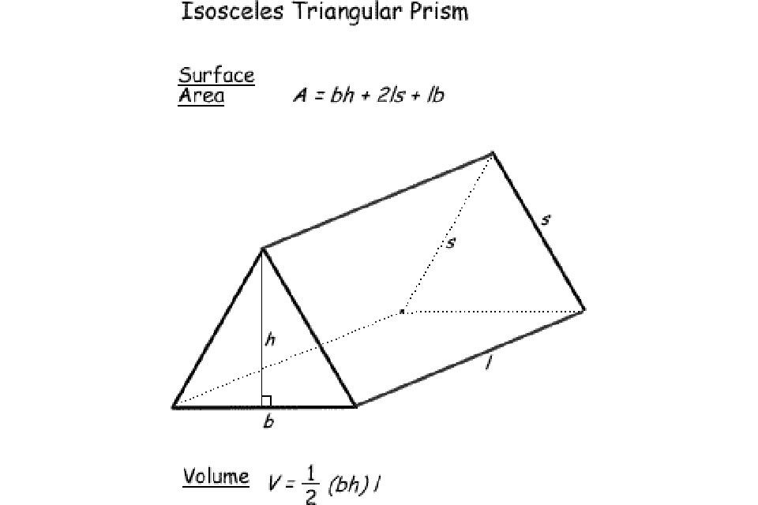
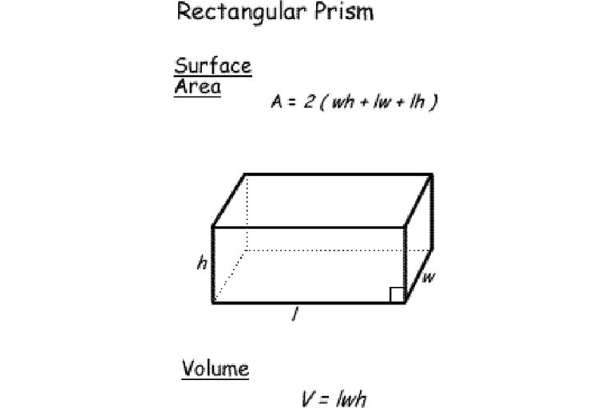
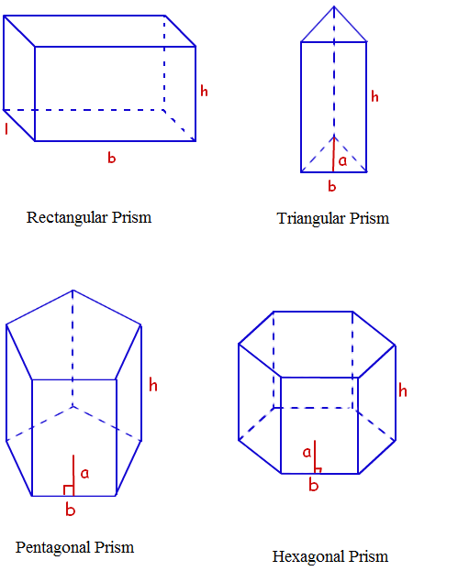
Prism
It is three-dimensional body with two parallel bases, made of identical polygons.

Slide 6
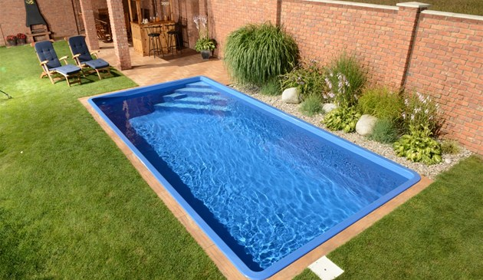
Cuboid
It is three-dimensional body, which is made of 6 rectangles (can be 6 squares)
We can find cuboid - pools...

Slide 7
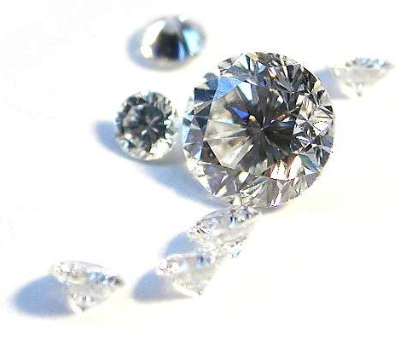
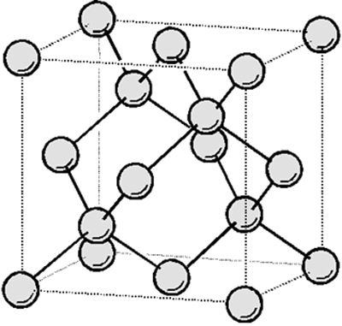
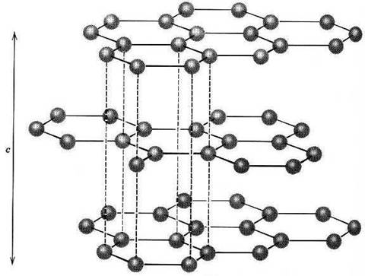
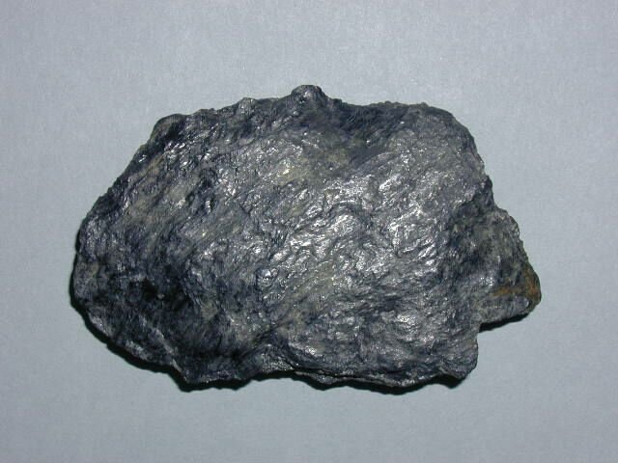
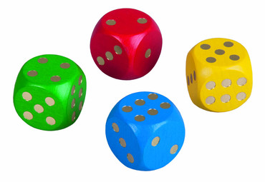
Cube
It is three-dimensional body, which is made of 6 same squares.
We can find cube in board games, grafit, diamonds…

Slide 8
Examples

Slide 9
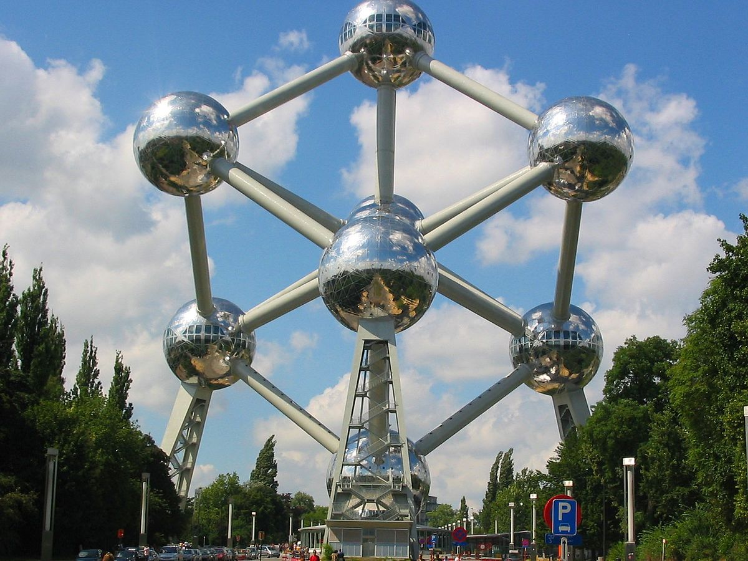
Atomium, Belgium
The Atomium depicts nine iron atoms in the shape of the cubic unit cell of an iron crystal
Magnified 165 billion times

Slide 10
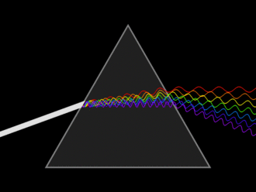
Prism
waves shown to illustrate the differing wavelengths of light.

Slide 11
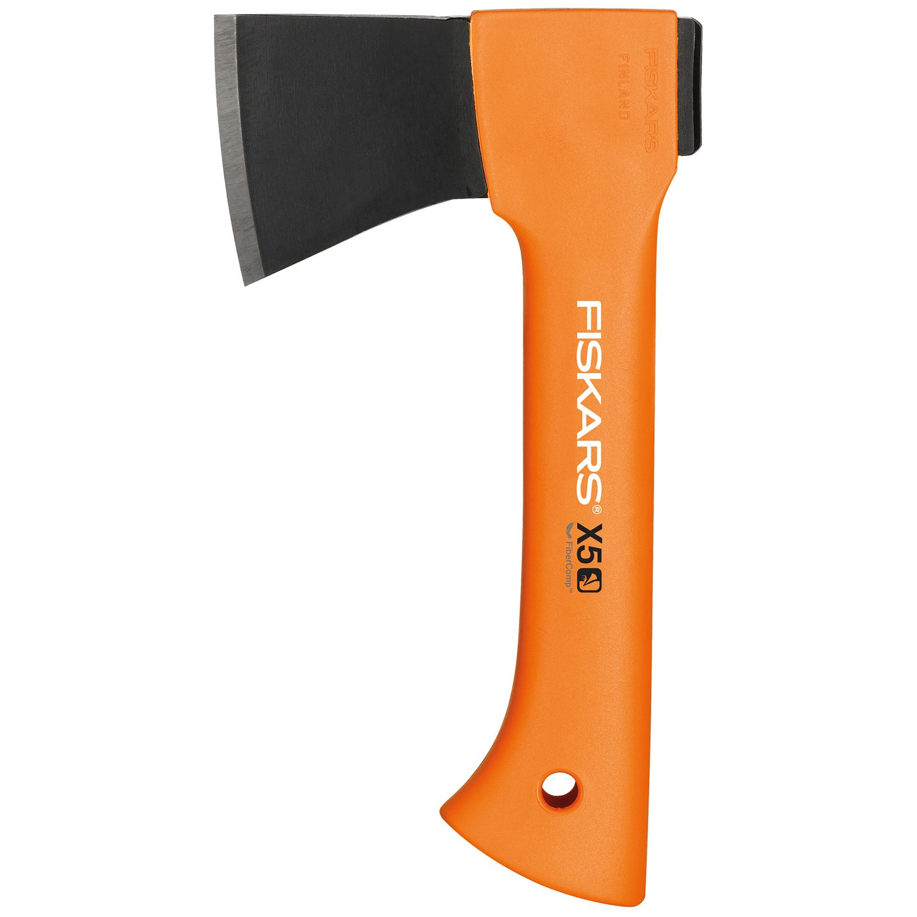
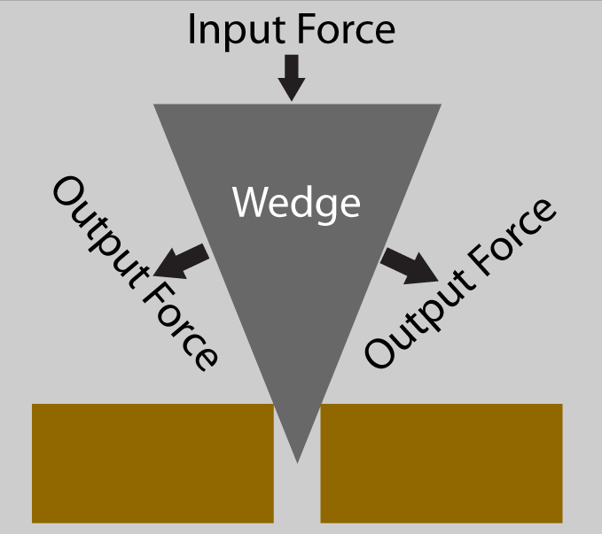
Wedge
ex., an Axe

